Slide 1
Introduction to Human Sciences
Literature Module
Lecture 2: “Good” vs “Bad” Culture

Slide 2
What does it mean then to study culture/s and its manifestations?
Strong interlinkages of Culture with Power
Aristotle – truth arrived at through knowledge
Knowledge should direct practice in arts and science

Slide 3
Hierarchies of Knowledge
Nadir – Functional knowledge of everyday necessities of life (food, clothes, shelter, sex)
Zenith – Philosophic knowledge that has no purpose outside itself (affords men felicity and leisure)
Fundamental break between the useful and the beautiful
Beautiful, “pure” theory congeals into an independent activity

Slide 4
Practice is no longer guided by truth arrived at through knowledge. Labour vs contemplation
An economic hierarchy of labour can be traced
“lower” order activities divorced from beauty and thought produce a class of men dedicated to production of goods
Wealth/well-being depend on opaque market forces, while he (worker) has not access to beauty

Slide 5
Class Structures are produced
Caste structures perpetuate this division
Peasant/Serf vs Priest/Brahmin
In capitalism, the commodity attempts to replace truth/beaty
Science/technology vs Humanities, Philosophy

Slide 6
Pursuit of the Highest good/truth is a “luxury”
So, we end up with a hierarchy of truths mirrored in a social hierarchy
In the face of social contradictions, Idealism retreats – in Aristotle
The material world should be transformed by the truths revealed by knowledge of Ideas

Slide 7
History of Idealism is the History of coming to terms with the established order
CULTURE is that negotiation
It mediates between Idealism and material conditions of exploitation and profiteering

Slide 8
Capitalist Epoch
Universal validity of “culture”
You are not born into labour/leisure
You are in a pure exchange of labour and services i.e., your personal qualities/needs don’t matter except as commodities
Your higher ideas – to God, truth, leisure, beauty are tested against a universal set of values we call “culture”

Slide 9
Desert of the Real
Here, sameness is essential
Rather minute differences that ultimately produce sameness
Fashions that produce a rhetoric of individual choice
Egs. Modern day ones – Ranbir Kapoor’s entire career is about watching a grown petulant boy hopefully becoming a man
Beards, Slim Pants, Coffee, Trekking, photography, Graphic Design – Hipster

Slide 10
A universally obligatory, eternally better, more valuable world must constantly be affirmed – a world removed from the facticity of daily struggles, yet realizable from within each individual without transforming the world
“Civilization and Culture” – where Sublime Beauty and antagonistic relations of existence are stabilized and pacified

Slide 11
Culture – Supposed to be concerned with every individual’s claim to happiness
Root of Culture – hierarchies of antagonisms
Society reproduces itself through economic competition
Here, happier social existence is rebellion – Maruti, Amazon, Bangladesh Sweatshops, Refugees vs migrants

Slide 12
Culture belongs to he who has internalized a proper mode of behaviour
He who comprehends the truths of humanity as battle cry is a rebel (Nargis vs Satyajit Ray)
Culture – ennobles, speaks of the dignity and freedom of man without freeing him

Slide 13
Beauty and truth, contemplation and intellection then are “cultural” activities
Both sublimated and internalized
Neither forms allow real material conditions to change
Culture perpetuates forms of systemic/epistemic oppression

Slide 14
At the same time, culture is that which escapes the confines and language of power disrupting the narrative of political and capitalist formation.
Such escapes are short lived, and quickly co-opted

Slide 15
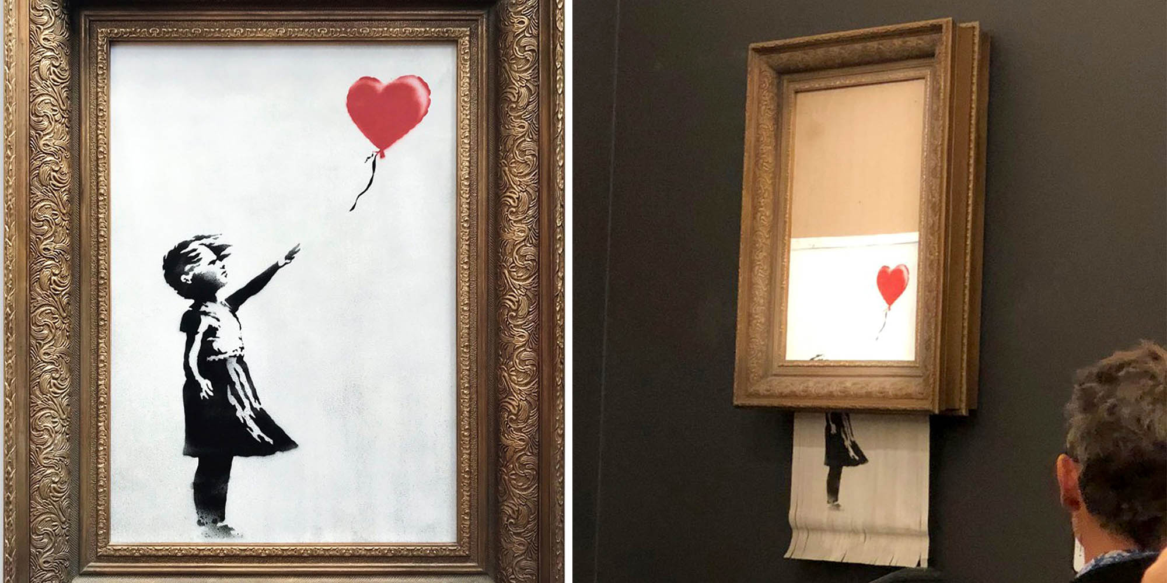

Slide 16
Pop art/Culture
Popular art is not art that has attempted and failed to be real art, but art that operates within the confines of the popular
While retaining much in common with folk art, it became an individual art, existing within a literate commercial culture

Slide 17
The artist replaced the anonymous folk artist, and the style was that of the performer rather than a communal style.

